Slide 1
Hierarchical reward and decision making
department < ... >
research group < ... >
Behavioural and EEG signatures

Slide 2
Topics
RL and the ACC
Subgoals, bottlenecks, and events
Tasks and models
Preliminary simulations

Slide 3
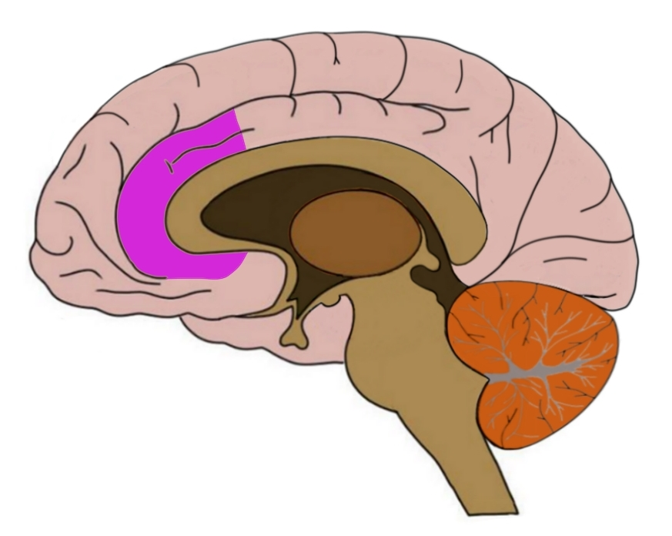
RL and the ACC

Slide 4
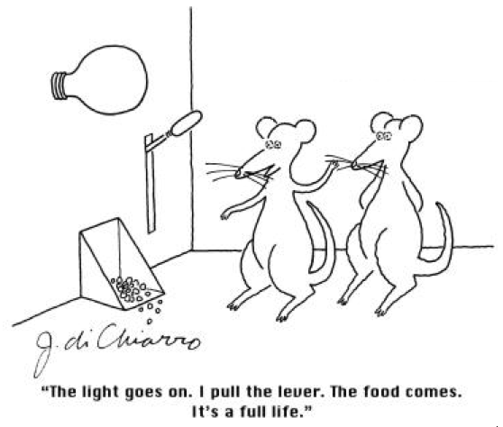
The Reward positivity
Reward Prediction Error (RPE)
Temporal Difference Learning (TD)
Model-Free Reinforcement Learning (MF-RL)

Slide 5
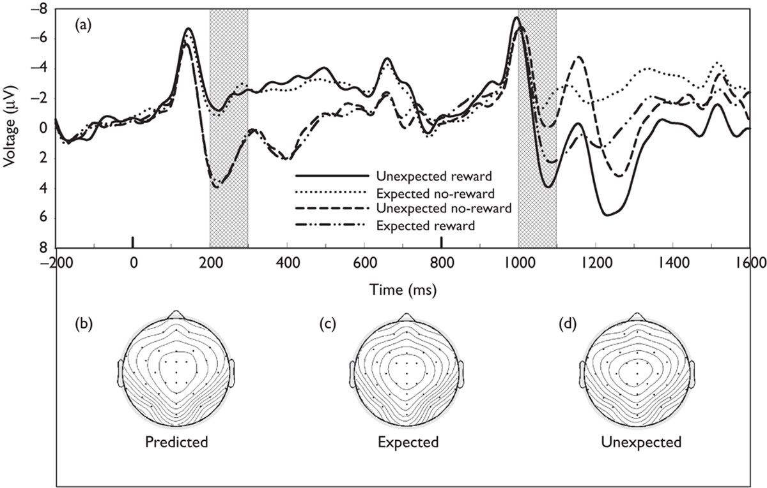
The Reward positivity
Holroyd, Kriegolson & Lee (2011)

Slide 6
Choice values
Represents EV over different time scales (Seo & Lee, 2007)
Feature specific (Oemisch et al., 2019)
Larger RPE predicts larger cue-induced FR during choice
→ Lookup table?

Slide 7
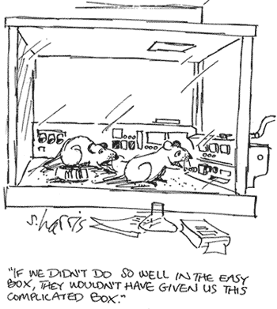
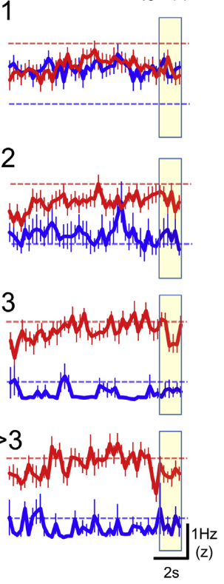
Reversal learning
Action-Outcome Monitoring

Slide 8
Volatility
Certainty of optimal bandit?
More bayes/stat tracker than RL?

Slide 9
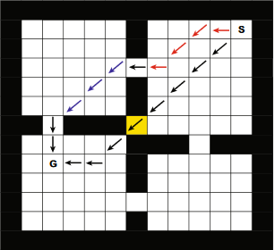
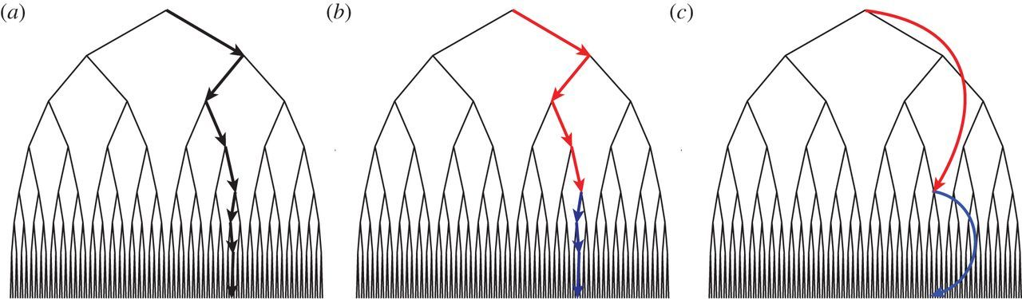
Hierarchical reinforcement learning

Slide 10
Subgoals
Identification
Maintenance

Slide 11
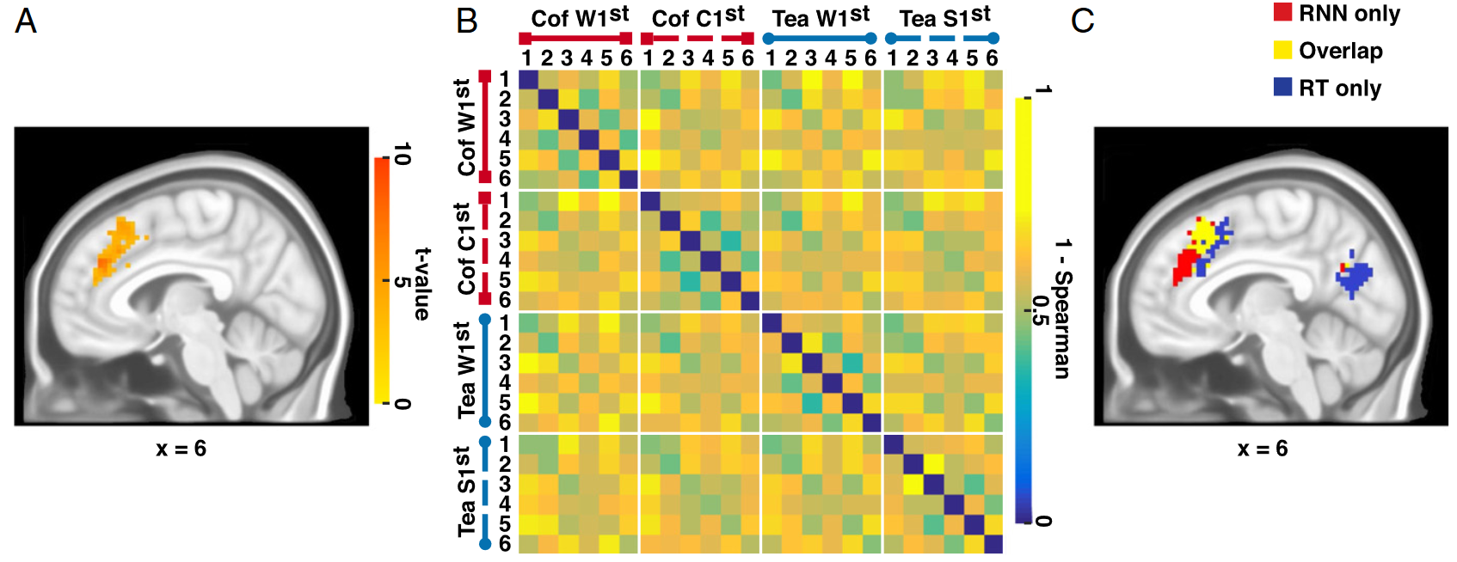
Subgoal Maintenance
Progression through the coffee-tea task

Slide 12
Subgoal maintenance
Task sets and strategies as abstract actions?

Slide 13



< presenter’s name > < job title > < DEPARTMENT OR RESEARCH GROUP > E <first name>.<surname>@ugent.be T +32 9 000 00 00 M +32 400 00 00 00 www.ugent.be
Universiteit Gent @ugent
@ugent Ghent University

